Slide 1
Title: Corporate Office Network Infrastructure
Presented By:
Name: Chinmoy Debnath & Name: Promod Chandra Das
Id: 231902029 Id: 231002005
Department: CSE Departmet: CSE
Subject: Computer Networking LAB
Presented To:Fatema Akter
01

Slide 2
Agenda
Introduction
Motivation
Problem Statement
Design Goals/Objectives
Applications
Devices & Services Used
Implementation Workflow
Results
Conclusion
Limitations
Future Work
02

Slide 3
Introduction
Project: Corporate Office Network Infrastructure
Purpose: Design a structured and secure network
Focus: Reliability • Security • Scalability
Tool Used: Cisco Packet Tracer
03

Slide 4
Motivation
Why we developed this Project :
1.Need for a structured office network to avoid chaos
2.Manual IP setup causes errors and wasted time
3.Unsecured networks risk data breaches and misuse
4.Organizations demand scalable, reliable connectivity
04

Slide 5
Problem Statement
Unstructured office networks cause IP conflicts and poor resource management
Manual configuration leads to errors, downtime, and inefficiency
Lack of security controls exposes sensitive data to unauthorized access
No scalability to support future growth or additional devices
Inefficient communication between departments due to weak routing
05

Slide 6
Objectives
Design a structured office network with Access, Core, and Distribution layers
Automate IP allocation using DHCP to avoid manual errors
Ensure secure file sharing using ftp
Implement dynamic routing for seamless inter-department connectivity
Build a scalable network that supports future expansion
Validate performance through simulation in Cisco Packet Tracer
Figure: 2
06

Slide 7
Applications
Corporate offices – secure and efficient internal communication
Universities/colleges – structured networking for labs and admin blocks
Banks and financial institutions – reliable and protected data flow
Hospitals – seamless access to patient and departmental records
Government offices – organized, scalable, and controlled connectivity
07

Slide 8
Devices & Services Used
Pc
Router
Switch
Laptop
Server
Services:
STATIC ROUTING
DYNAMIC
DHCP
FTP[Admin Full acess,But another client are read,write access]
EMAIL
08

Slide 9
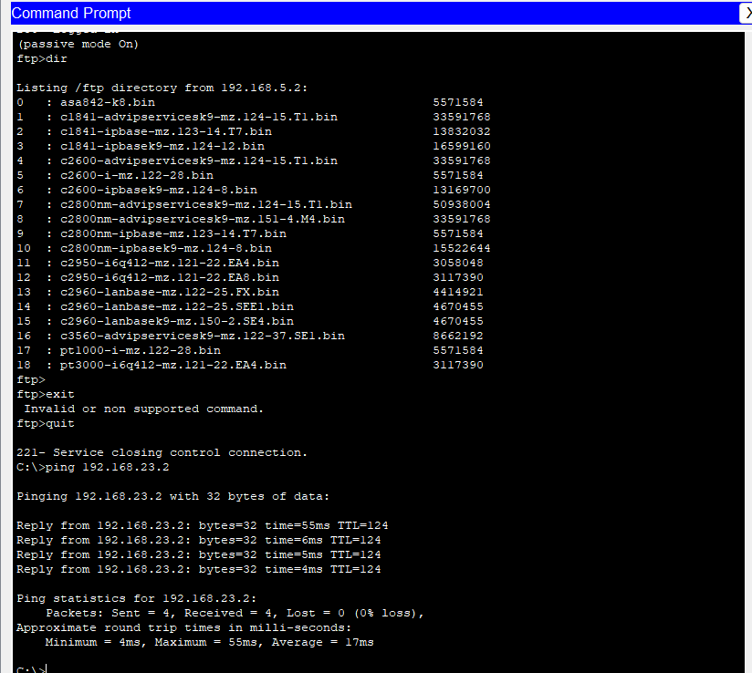
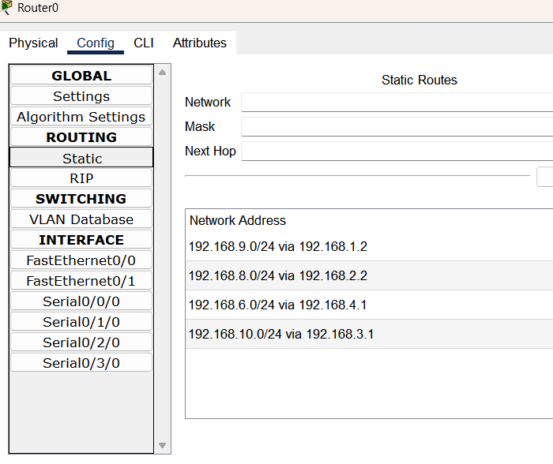
Implementation Workflow
09

Slide 10
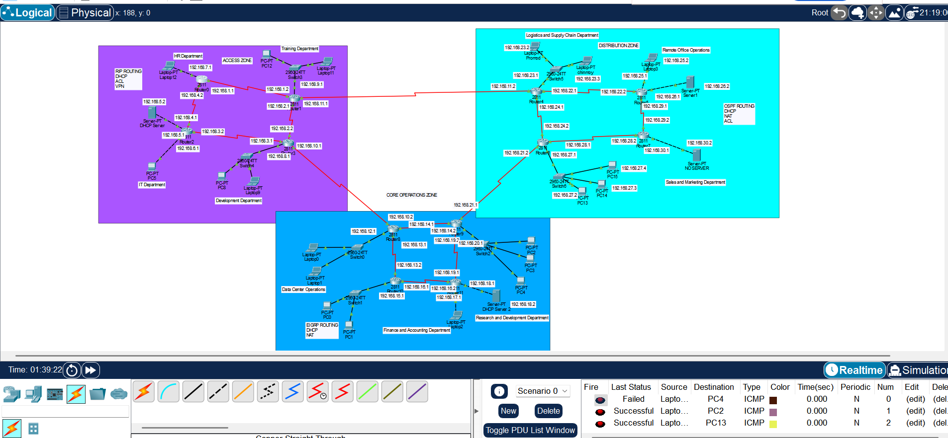
Results
11

Slide 11
Limitations
Simulation only – not tested on real hardware
IPv4 only – no IPv6 implementation
No advanced security tools like firewalls or IDS/IPS
No wireless integration in the current design
Bandwidth and latency not measured or optimized
13

Slide 12
Future Work
Implement IPv6 for next-generation addressing
Add wireless networking for mobility and flexibility
Integrate advanced security (firewalls, IDS/IPS)
Expand to hybrid/cloud networks for remote offices
14

Slide 13
Conclusion
Successfully designed and implemented a corporate office network infrastructure
Network divided into Access, Core, and Distribution Zones for structured communication
DHCP ensured automatic IP allocation and avoided conflicts
Dynamic routing enabled efficient inter-zone communication and scalability
NAT provided secure external connectivity while protecting internal addresses
ACLs enforced traffic control and security policies
Simulation tests (Ping, Traceroute, Packet Flow) confirmed smooth communication & security
Overall: Project demonstrates how a well-planned network improves productivity, security, and scalability
12

Slide 14

Any Questions ?
17

